Slide 1
The Cool Code Consortium
6-28-2017
Notes:
Use this for Pro Audio Segments

Slide 2
Stuff
High Level vs. Low Level
Cool News
Digital Circuits/VHDL
Next Week

Slide 3
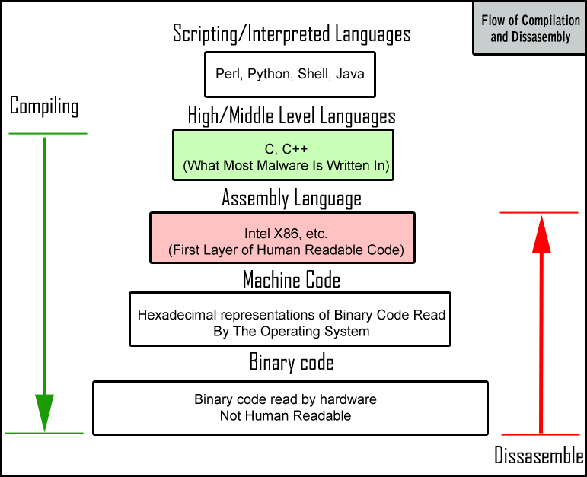

Slide 4
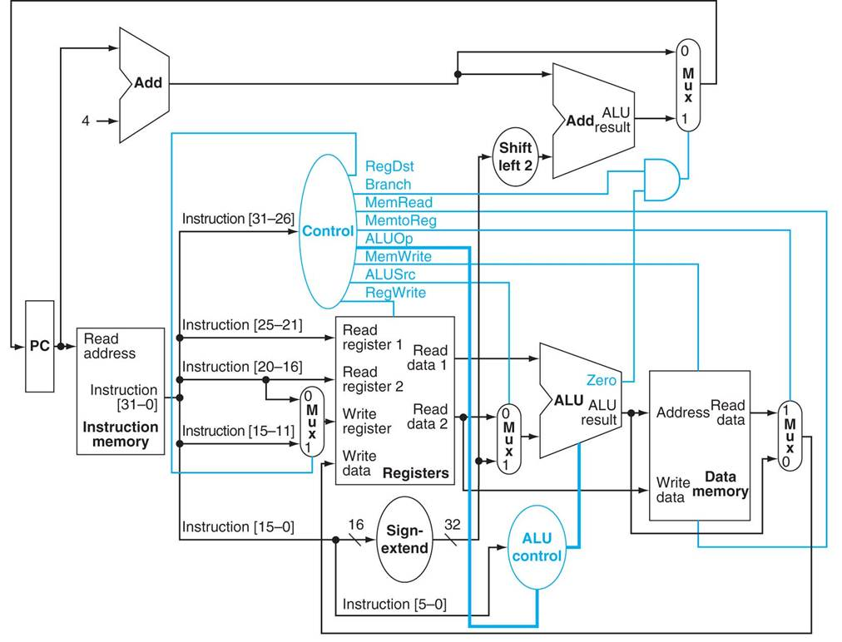

Slide 5
Cool News
https://www.developer-tech.com/news/2017/jun/21/microsoft-building-online-raspberry-pi-simulator/
https://hackernoon.com/why-snap-map-is-a-big-deal-cf972744a3e4

Slide 6
Digital Circuits / VHDL

